Slide 1
Thoughts on CGT changes

Slide 2
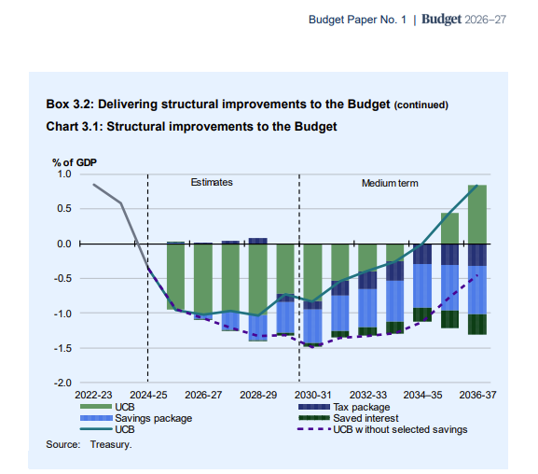
Key policy directions of Federal Budget 2026
Budget 2026 took place given rising concerns about fiscal sustainability, intergenerational equity, and productivity growth – three topics that are closely linked.
NDIS reforms.
  Details are currently limited – but these savings were the main drivers of surplus returning.
  Thriving kids program a significant part, however a lot of community and social support likely to be removed.
Tax reforms.
  WATO and the future taxation of labour income.
  Liquidity and R&D policies for small and young firms.
  Minimum trust tax rate.
  Capital gains and negative gearing.

Slide 3
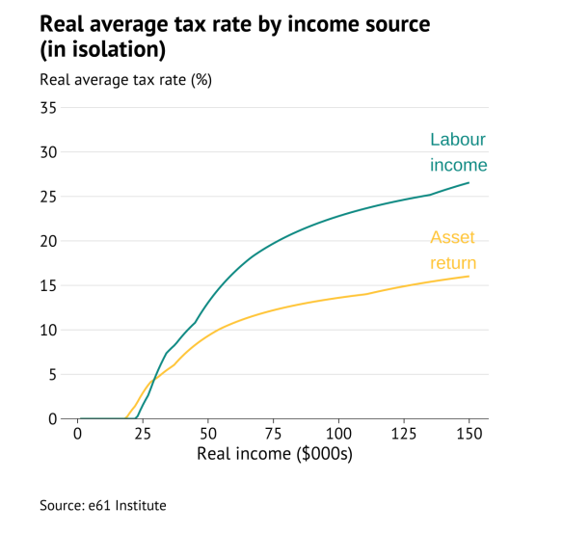
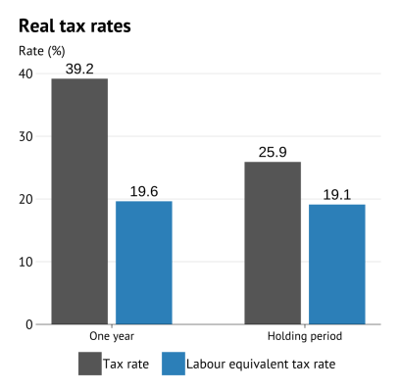
Taxation of income
Understanding taxation of capital gains requires thinking about income tax.
Tax capital like wages? Intergenerational equity? Equity-efficiency trade-off.
What is income?
Tax changes in the capacity to consume irrespective of how we do so (https://e61.in/e61-capital-income-tax-calculator/).
Fixer-upper sale
High inflation property investor

Slide 4
Taxation of income
Understanding taxation of capital gains requires thinking about income tax.
Tax capital like wages? Intergenerational equity? Equity-efficiency trade-off.
What is income?
Tax changes in the capacity to consume irrespective of how we do so.
Capital income as a return to savings.
Inflation reduces the value of nominal savings – not income.
A normal rate of return compensates for deferring consumption – necessary to maintain present value of savings, so not income.
To tax all true income the same way we can either tax consumption, or tax labour income + capital income above a normal rate of return.
Hard to create the redistribution we may want with consumption taxes (progressivity). Hence an income tax is needed.

Slide 5
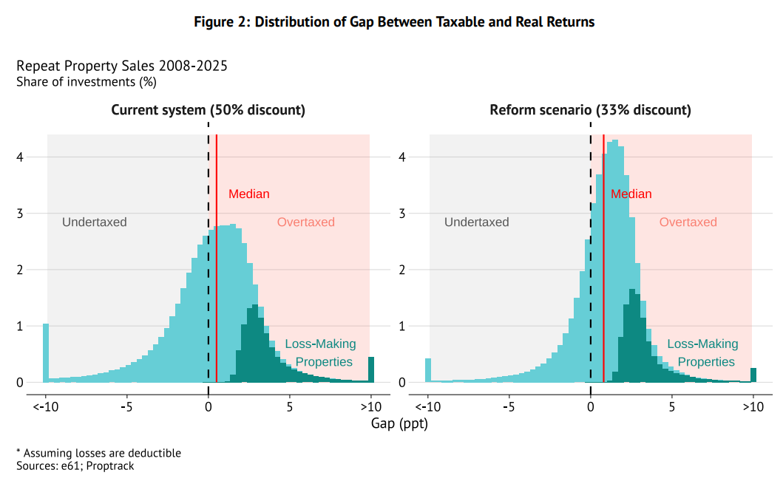
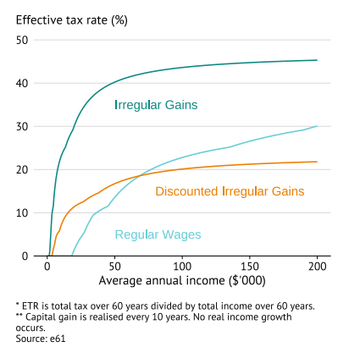
What are capital gains and negative gearing
A capital gain is an additional form of capital income.
Like other capital income, some of the dollar amount is not “income”.
Is taxed on realisation – this gives capital gain a deferral benefit relative to other capital income currently.
Due to progressive taxes, capital gains are taxed at a higher rate than if they were taxed each year.
Discount and income averaging

Slide 6
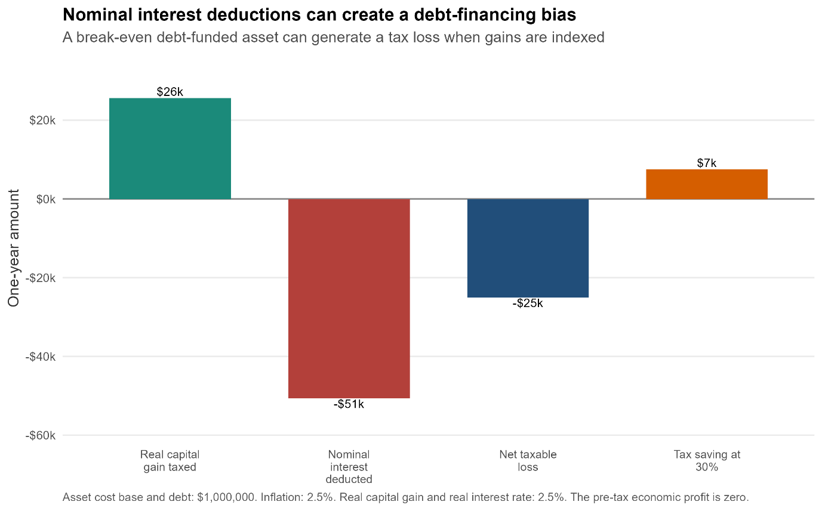
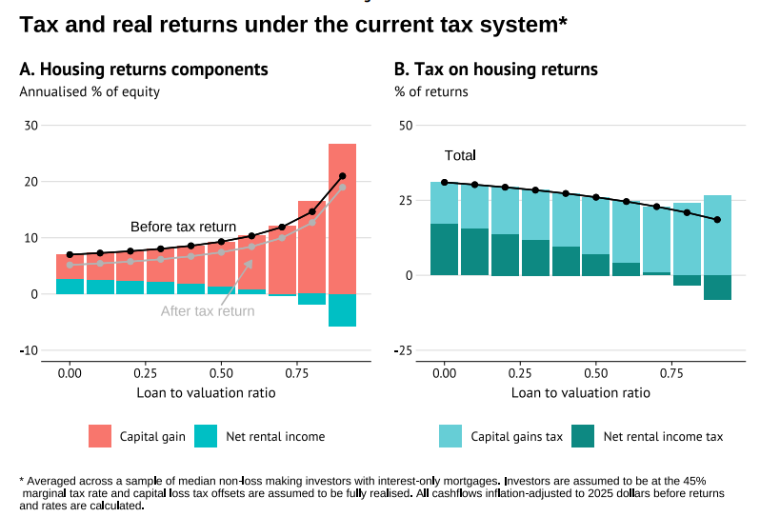
What are capital gains and negative gearing
Negative gearing is when annual revenue for an asset in a year is less than the costs, due to borrowing expenses.
Only allow expenses related to taxed income. Allowing deductibility of inflation component of interest inconsistent with discount/indexation.
Quarantining losses both punishes those with genuine losses (as all expenses are deferred) and over-credits those making positive annual rental income.

Slide 7
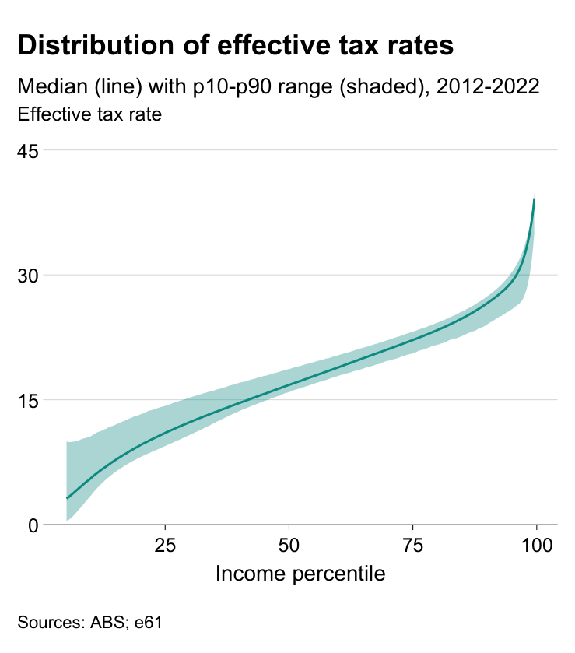
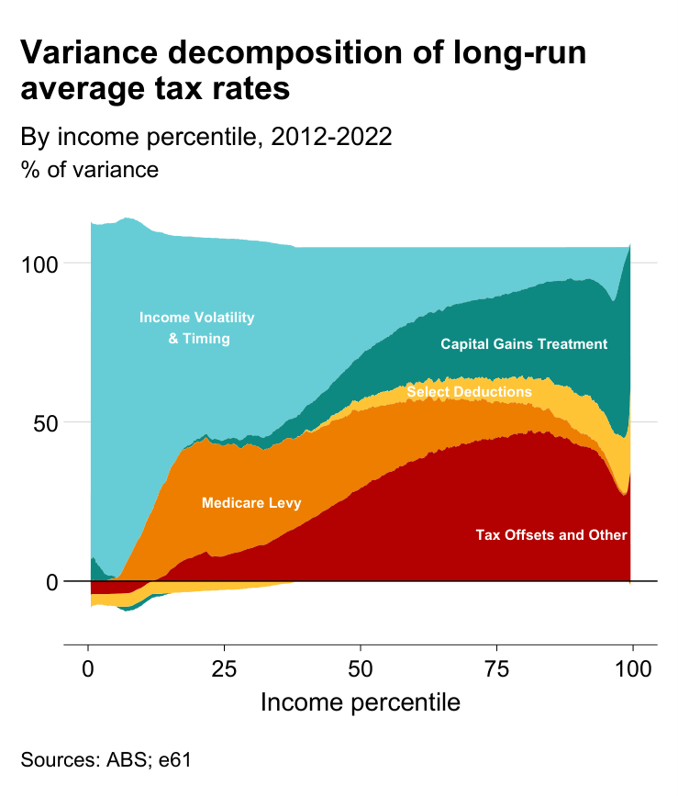
Issues with prior treatment
Horizontal inequity

Slide 8
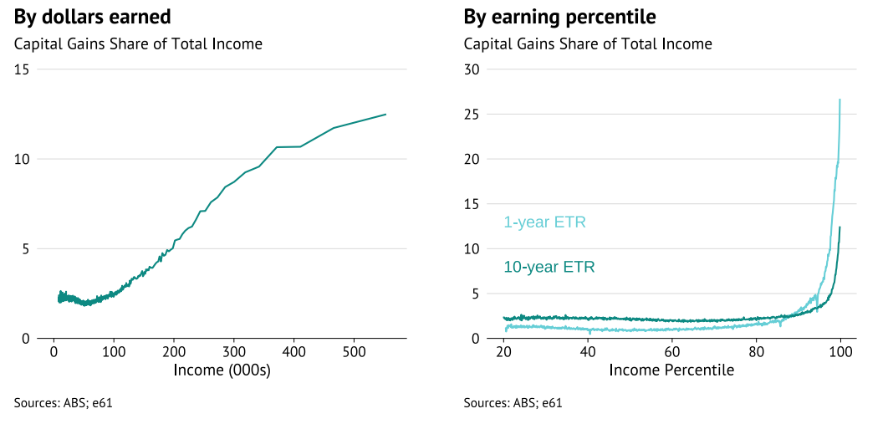
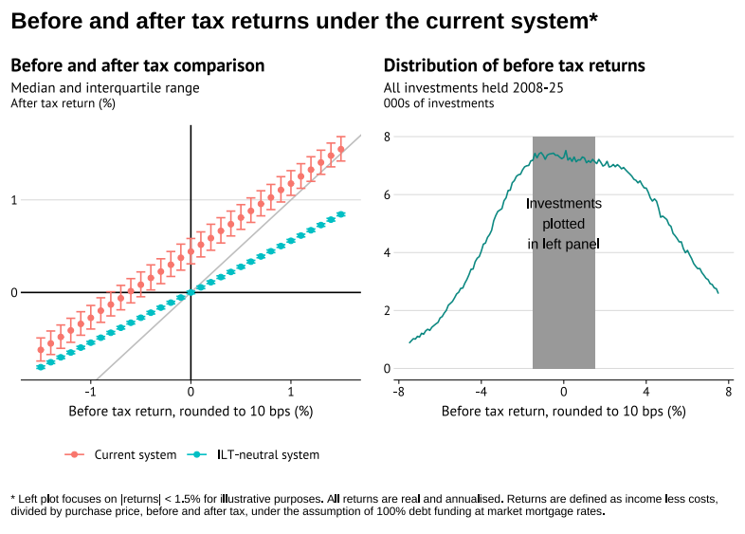
Issues with prior treatment
Vertical inequity
Capital gains tend to go to those with high
decade-long income.
Implies that the tax-system may be less
progressive than intended.
Incentive to borrow too much
Increasing leverage allows an investor to
increase their return on equity (RoE) post-tax
by more than the pre-tax increase.
-> Can turn a pre-tax negative return
positive post-tax

Slide 9
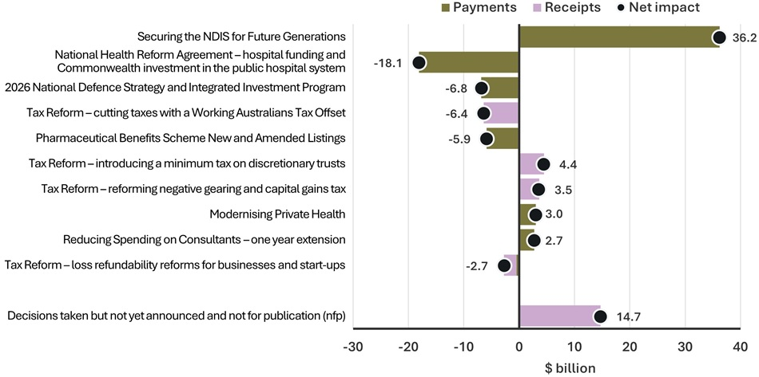
Implications for revenue
It was not clear these reforms should increase revenue – but it does.
Consistency would also discount other capital income.
Gain from change in distribution of tax rates.
Asymmetric treatment of losses.
No “income averaging” – over-taxation of lumpy income such as capital gains, incentives for strategic timing.
Minimum rates.
Is inflation the correct discount rate?

Slide 10
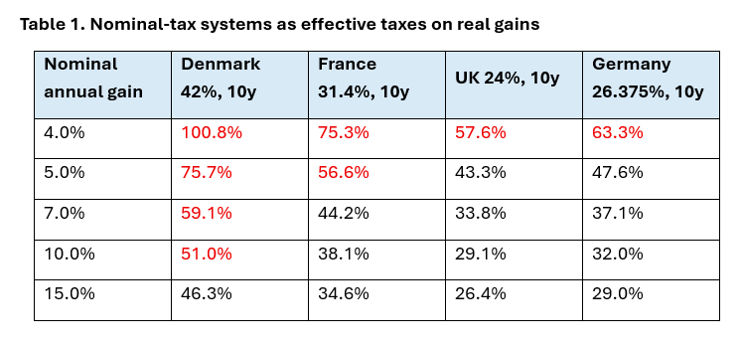
Trade-offs
Capital mobility and investment
Changing residence shifts taxation of “passive” housing capital gains.
Mobile ideas and finance can move – incidence passes through to consumers and business.
Domestic value-add is less mobile.
  International evidence suggests mobility from CGT is limited.
  Also suggests the general tax rate mobility is lower for sources that generate high returns (location specific rents).

Slide 11
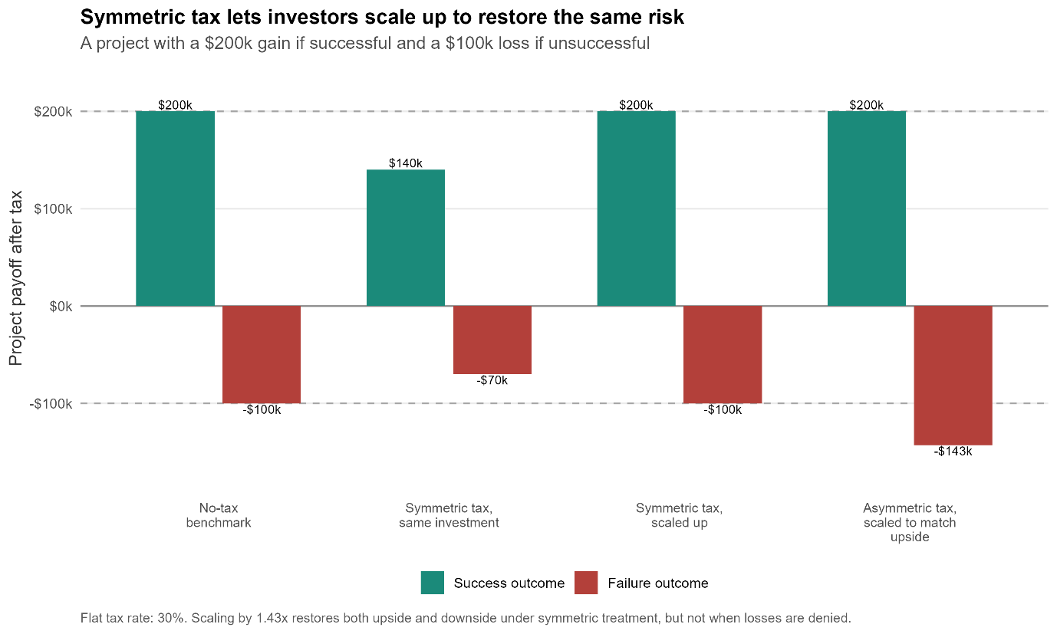
Trade-offs
Compliance costs
Different rules for different assets.
Complicated minimum tax rules (especially alongside trusts).
Transitional valuations.
Taxation of risk?
The reforms increase the taxation of risk.
In the absence of “asymmetry” this would be neutral/positive with respect to risk.
  Progressive taxes.
  Differential treatment of losses.
  Minimum rates.

Slide 12
Q&A

Slide 13
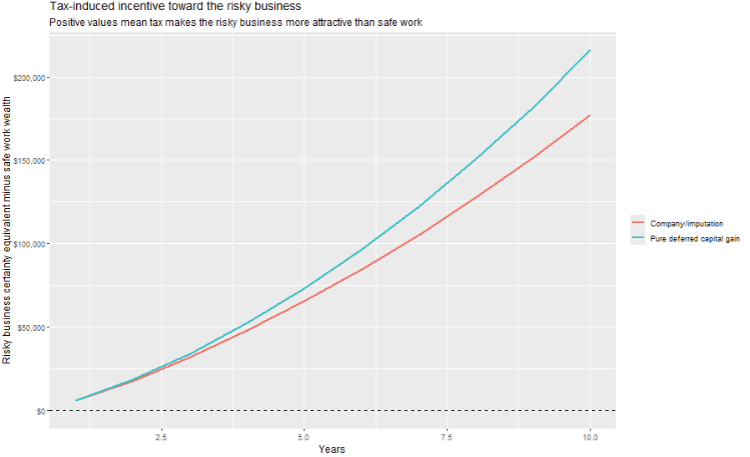
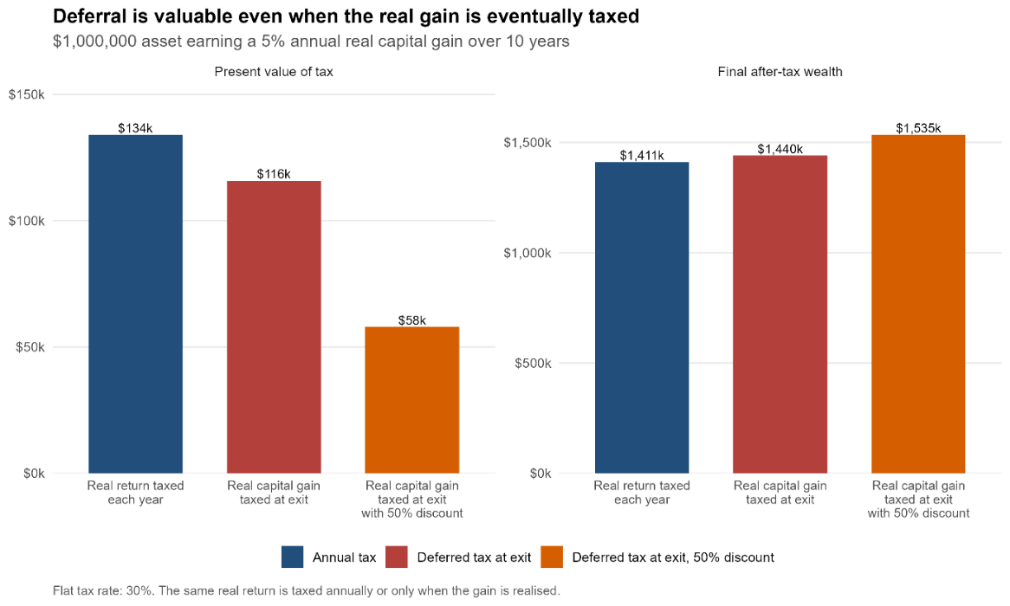
Additional plots
Flat tax incentive for risk-averse individual
Deferral without imputation

Slide 14
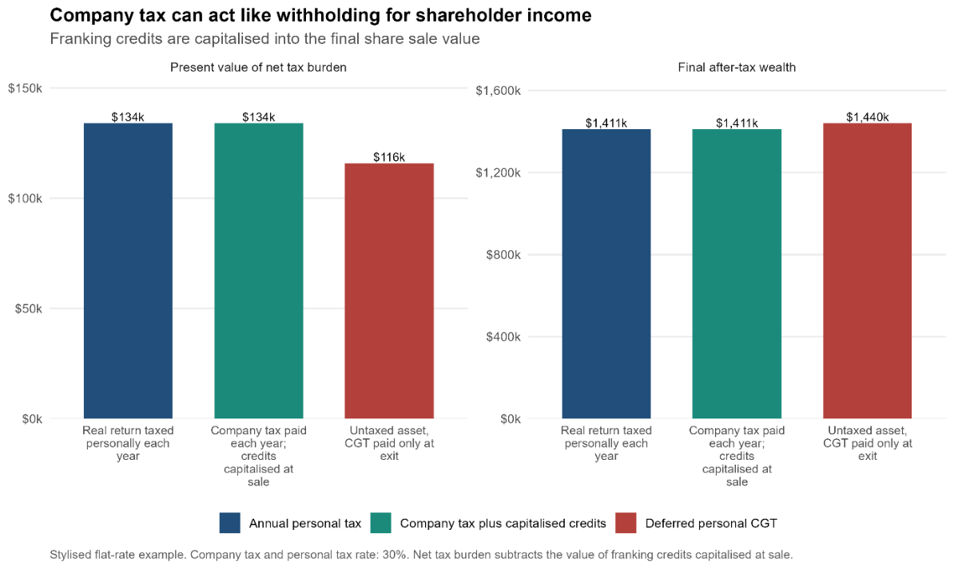
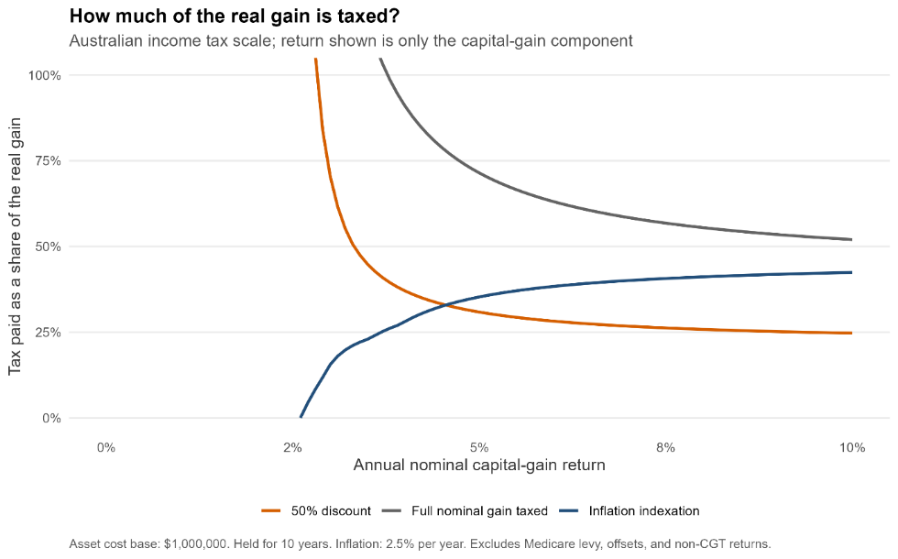
Additional plots
Deferral with imputation
Change in real tax rates by capital gain

Slide 15
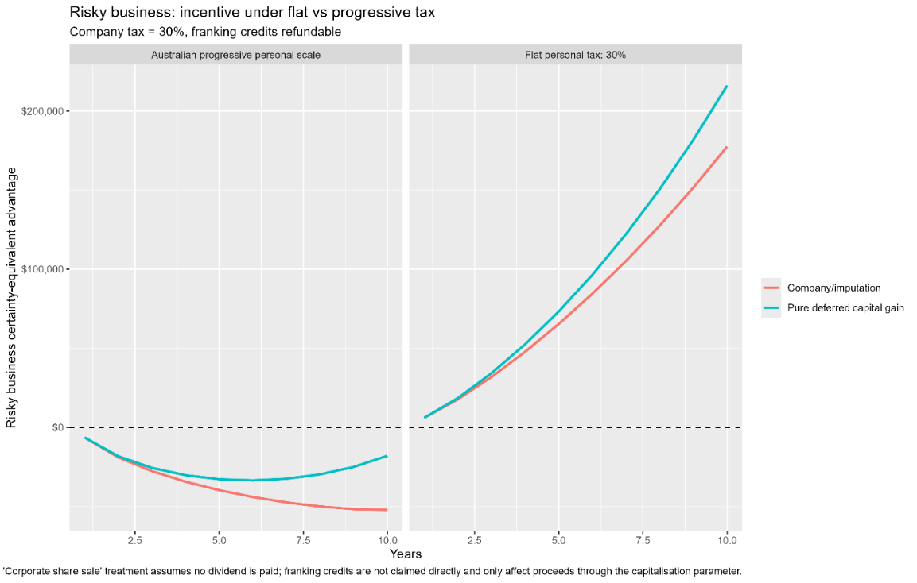
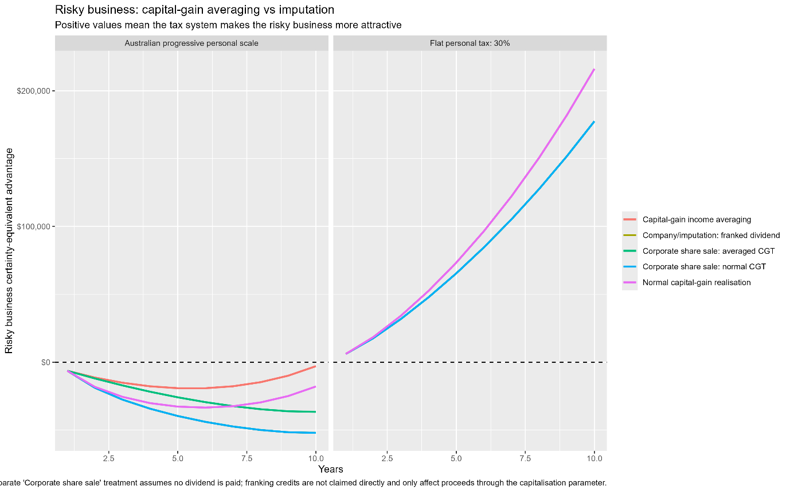
Additional plots
Progressivity and risk
Income averaging and risk

Slide 16
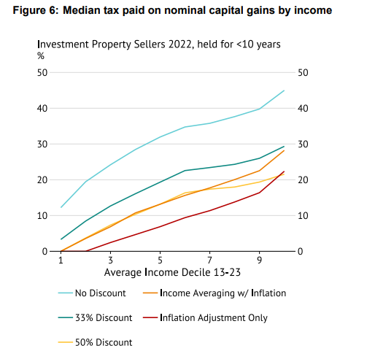
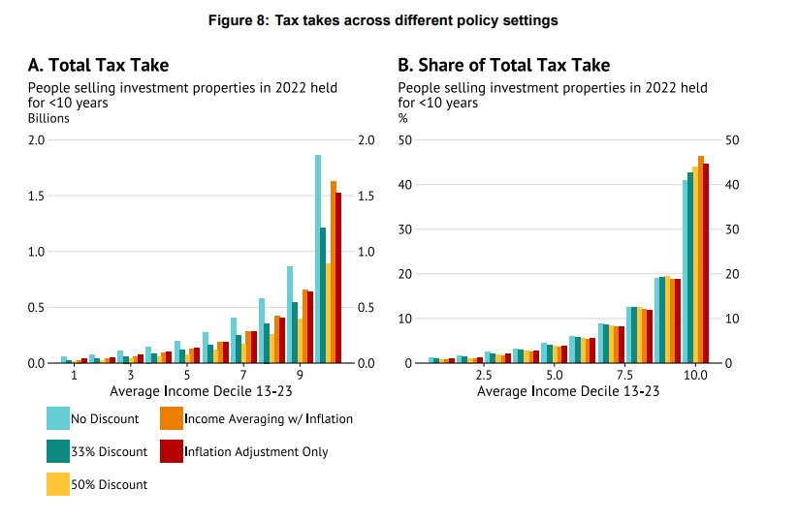
Additional plots
Housing median tax rates
Housing CGT revenue estimates

Slide 17
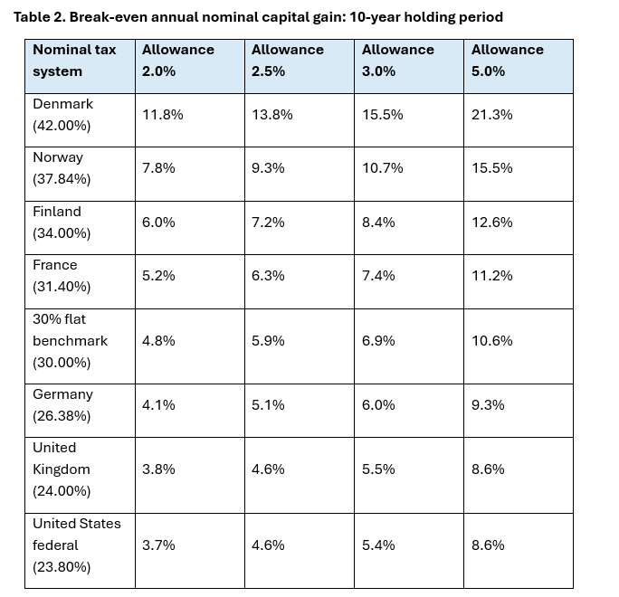
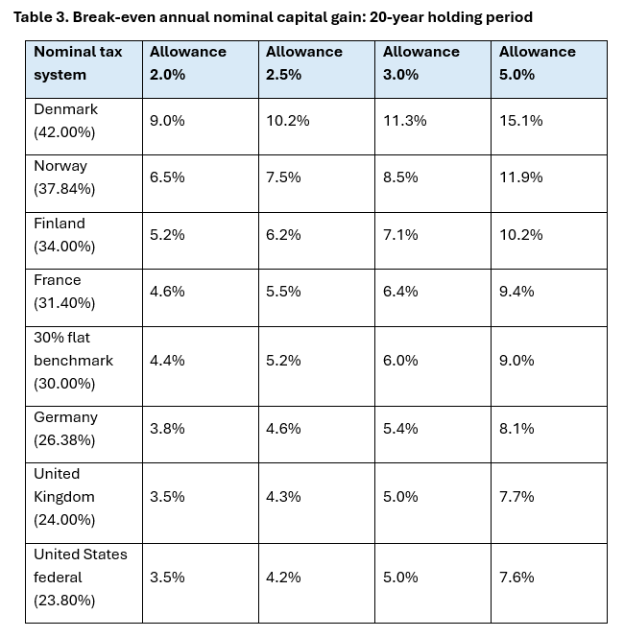
Additional plots
Breakeven international tax and “allowance” (with 2.5% inflation)

